Slide 1

55th AutoHotkey Webinar 01 /2021
The Webinar will begin in a few minutes
Joe Glines http://the-automator.com Joe@the-Automator.com YouTube
Jackie Sztuk https://jszapp.com Admin@jszapp.com

Slide 2
Ground Rules
Currently 82 Registrants
Everyone starts off muted
“be nice”
  Raise your hand if you have a question & you’ll be unmuted in due time
  Ask your question in the chat
  If your question is complicated, we’ll unmute you and you can ask directly

Slide 3
Announcements
84 - How AI /GPT-3 is affecting our world https://youtu.be/16GDAxcIYXc
85 - Working with large RPA Vendors that don't know what they're doing https://youtu.be/SeALfHMQ3zI
86 - Bring back Personalization to computers https://youtu.be/9r5sLmD7RX0
87 - Swiping on BlueStacks (the final cut) https://youtu.be/RszVnp7Scsc
New AutoHotkey Podcast Format coming soon! "The Automator's Podcast" ☺

Slide 4
AutoHotkey Mentorship site: Want to Learn / Able to Teach
https://Mentorship.the-Automator.com
Other topics:
Willing to pay Mentor
Needing to get paid for time being a Mentor
Primary Language
How use AutoHotkey
Contact information
API calls / Webservice APIs | MS Word
Automating programs with Controls | Programming with Classes
DLL Calls | Programming with Functions
Document Object Model (DOM) | Programming with Objects
File & Folder manipulation | Regular Expressions
Gaming Automation / Botting | Send Message / Post Message
GUIs (Graphical User Interface) | SQL Database Storage / Usage
Image Creation / Manipulation with GDIP | Text Manipulation
JSON Storage / Usage | Web Scraping with Chrome
MS Excel | Web Scraping with IE
MS Outlook | XML Storage / Usage
MS PowerPoint

Slide 5
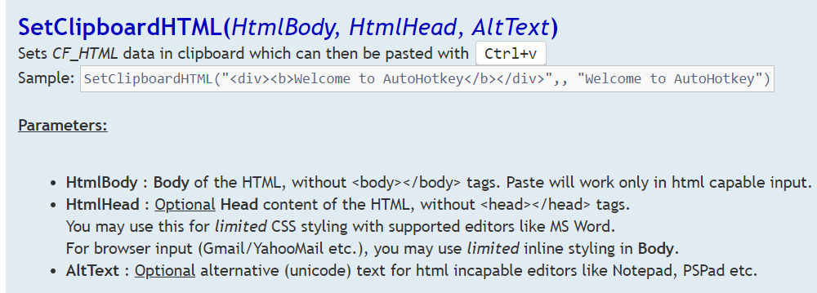
Script Highlight: SetClipboardHTML() by SKAN
https://www.autohotkey.com/boards/viewtopic.php?f=6&t=80706

Slide 6
2021 AutoHotkey User Survey
Jan 2021

Slide 7
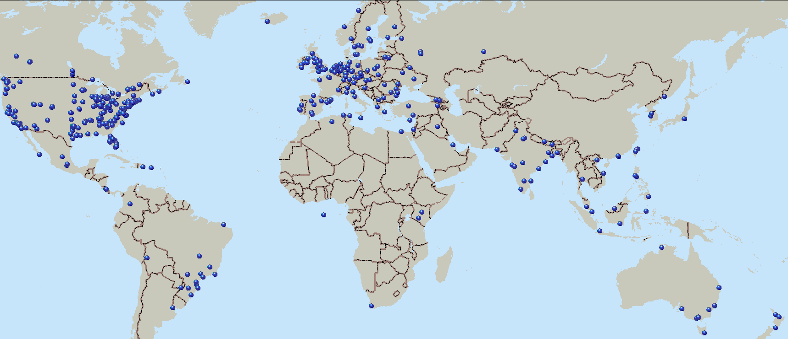
129 partials, 447 completes from 61 countries
N=576

Slide 8
Source of Respondents
N=440

Slide 9
How became aware of AutoHotkey
N=486

Slide 10
Years using AutoHotkey
N=572

Slide 11
What Regularly use AutoHotkey for
N=576

Slide 12
Changes in how using AutoHotkey

Slide 13
Additive Tree – AutoHotkey usage
Web Services APIs
Webpage Manipulation
Web Scraping
SQL / Database access & Storage
Object oriented
Manipulate other programs/objects w/COM
DLL calls
Registry editing
File manipulation / Disk management
GUIs
Regular expressions
Windows Send & Post Messages
Window Manipulation
Text Manipulation
Re-mapping of keys / Controllers
Hotstrings
Hotkeys
Image viewing / editing
Video playback / editing
Audio playback / editing
Gaming
Mouse manipulation
Finding / Clicking an image
N=576

Slide 14
Favorite use of AutoHotkey
N=486

Slide 15
Major changes in favorite AutoHotkey functionality

Slide 16
Preferred IDE
N=573

Slide 17
Change in Favorite Editor

Slide 18
Why not using AHK Studio

Slide 19
Sources frequently use to learn AutoHotkey
N=495

Slide 20
Sources Frequently use (2016 to 2021)

Slide 21
Additive Tree: Where people learn AutoHotkey
the-Automator com
Udemy
YouTube
AHK Webinars
AHK Podcasts
JSZApp com
Reddit
GitHub
Stack Overflow
AutoHotkey Documentation
Rosetta Code
AutoHotkey Forums
ComputerEdge
N=495

Slide 22
# Scripts Write & Use per Week
N=486

Slide 23
Competitive Tools used (23% didn't use any)
N=495

Slide 24
Change in competitive use

Slide 25
Additive Tree on Competitive Tools
UI Path
Selenium
AutoHotkey
Visual Basic / VBA
Windows PowerShell
DOS / Batch files
PhraseExpress
Autocorrect
WinAutomation
JitBit
ReMouse
qliner
Blue Prism
Hot Keyboard
Automation Anywhere
MouseRecorder.com
Macro Express
AutoIt
KeyboardExpress
iMacros
N=382

Slide 26
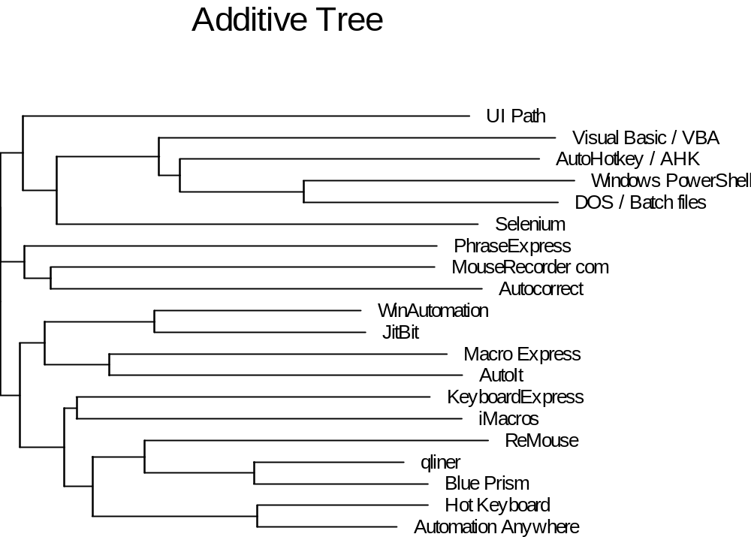
N=382

Slide 27
Languages Regularly program in
N=495

Slide 28
Languages with big changes in usage

Slide 29
Additive Tree: Programs Regularly Use
Ruby
Python
Selenium
Perl
Java
FORTRAN
SQL
PHP
ActionScript
JavaScript
HTML / CSS
C#
ASP
.NET
Visual Basic / VBA
COBOL
AutoIt
Pascal
DOS / Batch Files
LUA
AutoHotkey / AHK
C++
C
N=449

Slide 30
How does AutoHotkey Compare to these tools?
Min N=20

Slide 31
AutoHotkey at work
N=478

Slide 32
Making $ with AutoHotkey
N=478

Slide 33
Industry of Company work for
N=371

Slide 34
Size of Company work for
N=384

Slide 35
Job Function
N=416

Slide 36
Years of Work Experience
N=448

Slide 37
Respondent Age
N=437

Slide 38
Respondent Gender
N=434

Slide 39
Signup for Newsletter and Follow up to Responses
https://the-automator.com/News
N=576

Slide 40
Questions?
Thank you!

